Slide 1
The Zen of Coding
Day 1
Rutgers Coding Bootcamp

Slide 2

About Meeeeeeee!
Franklin Dawes
8 Years Professional Software Development
Born in
Grew up in Staten Island
Notes:
This class is, after all, about you – so let’s do some introductions.
(You may also want to ask “Fears about class?” – that can turn a little negative, so be ready to dissuade/make happy the students if you do ask this)

Slide 3

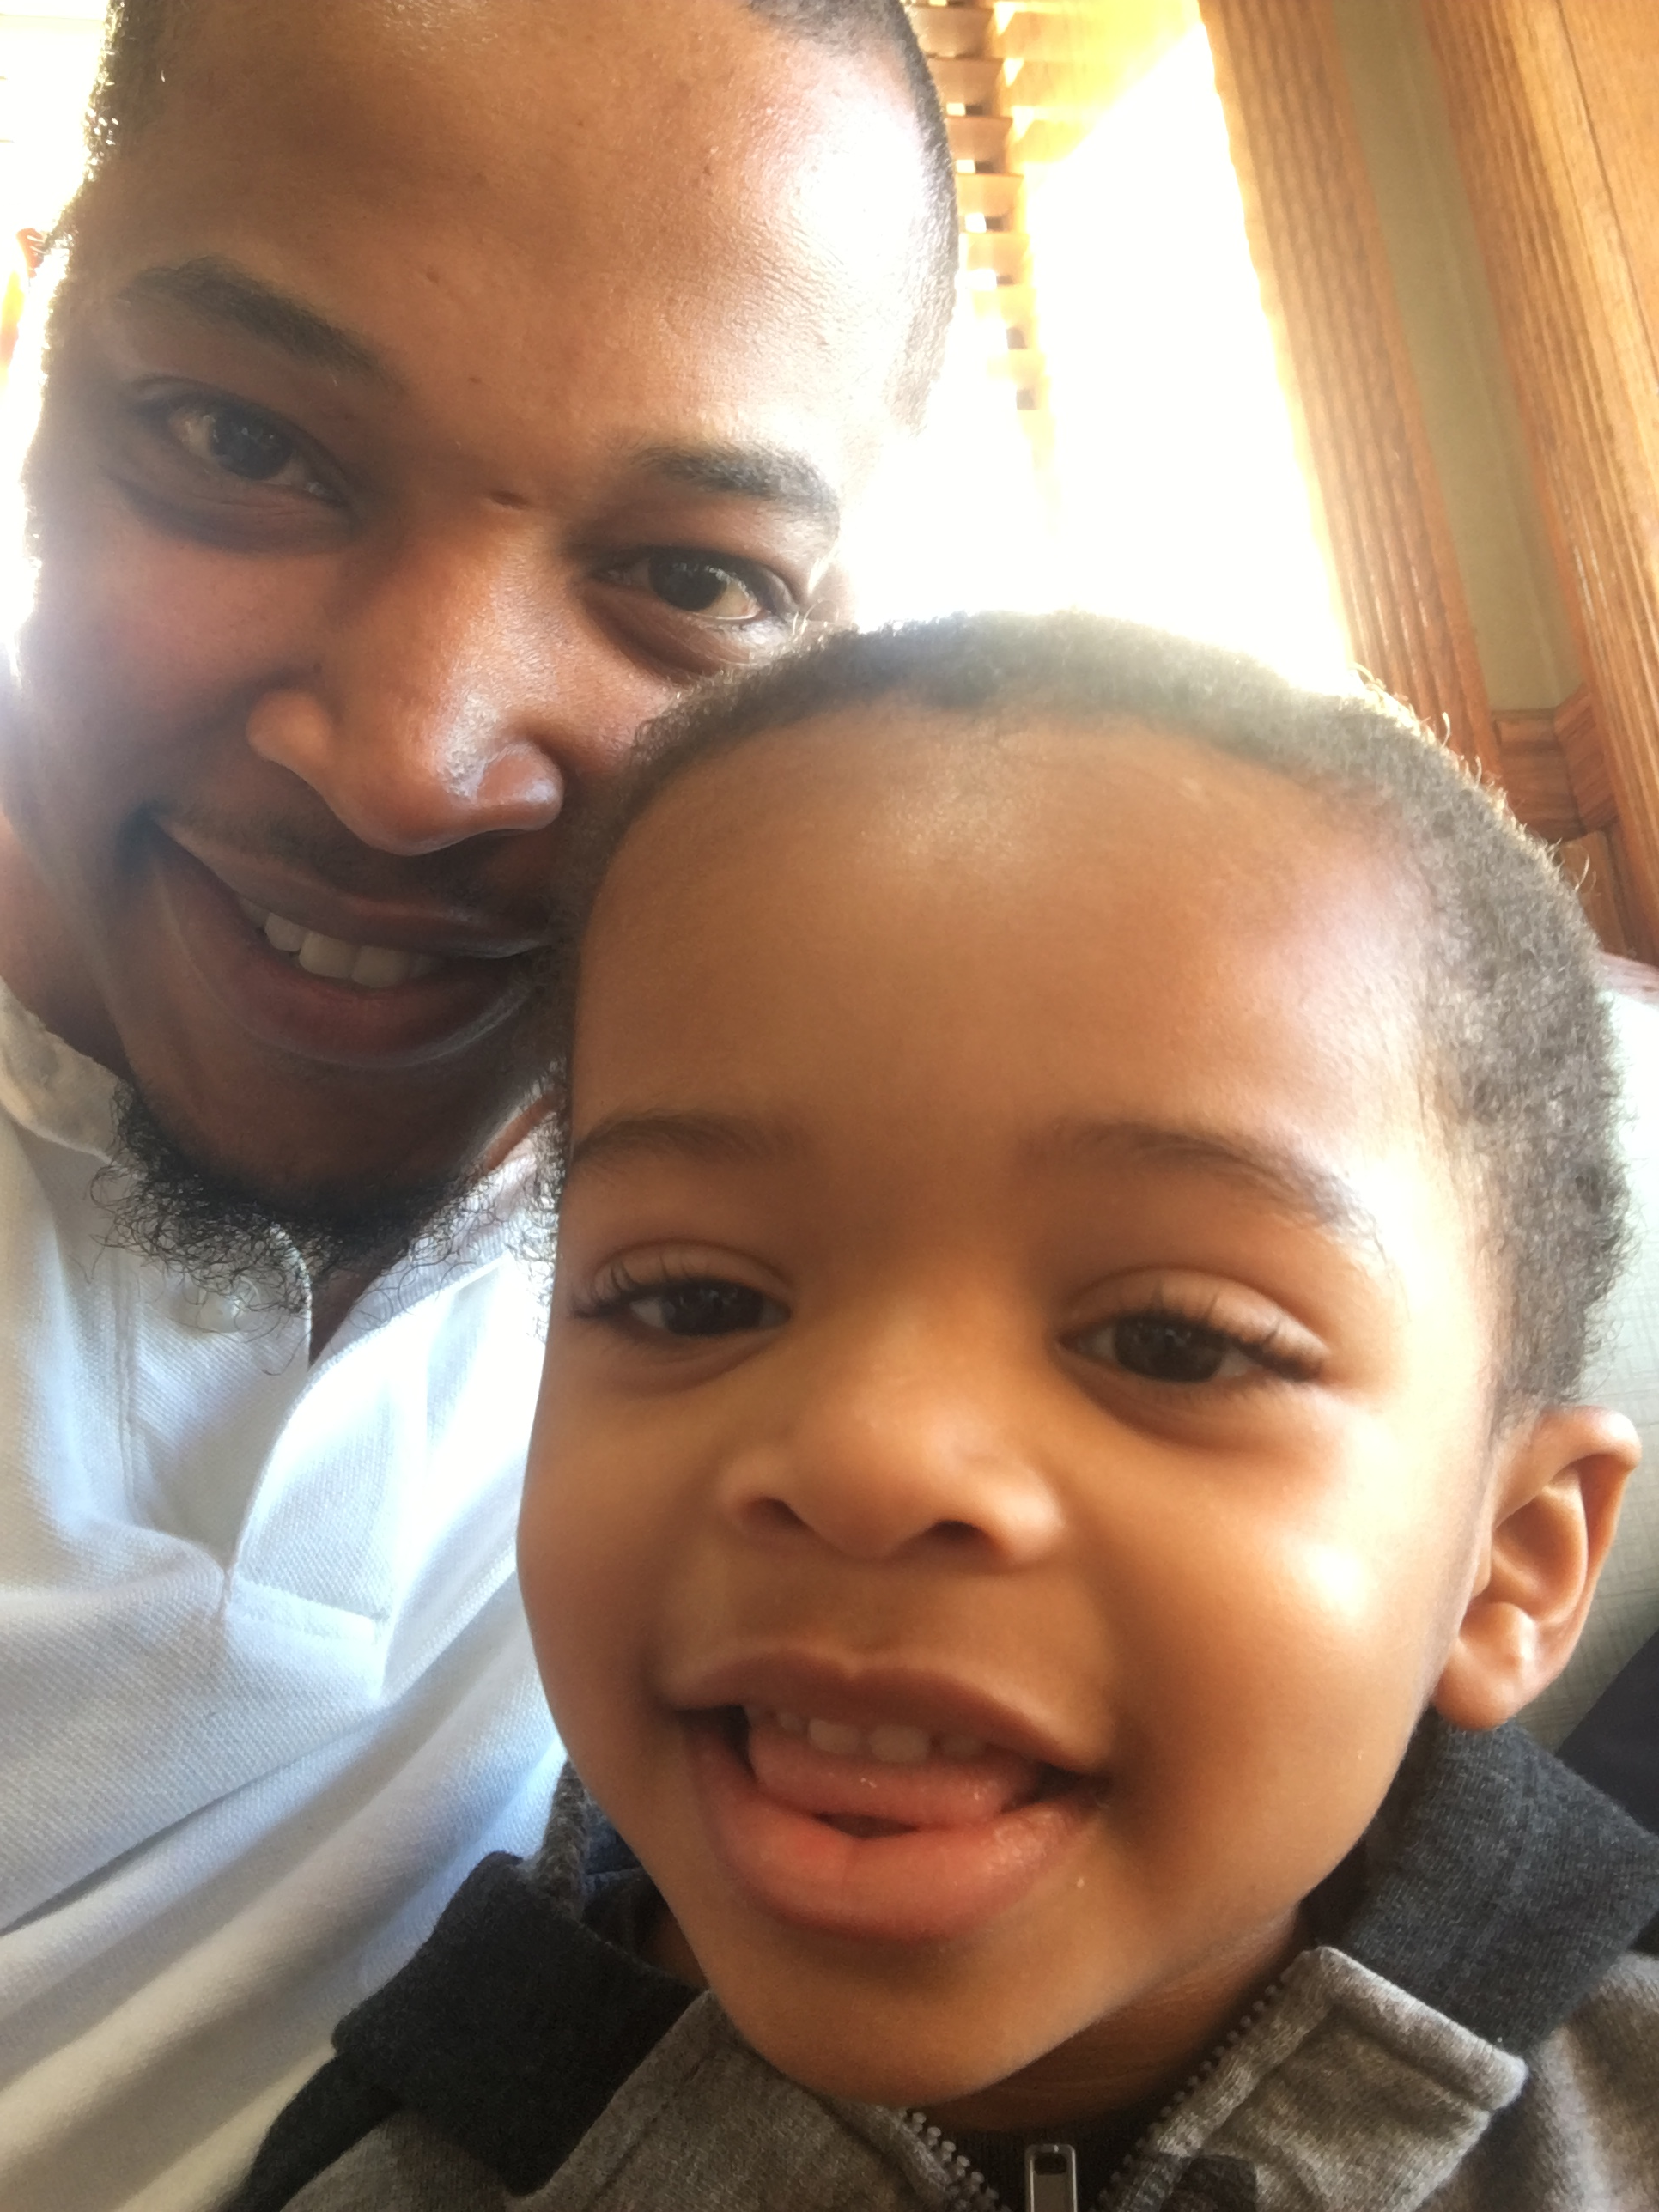
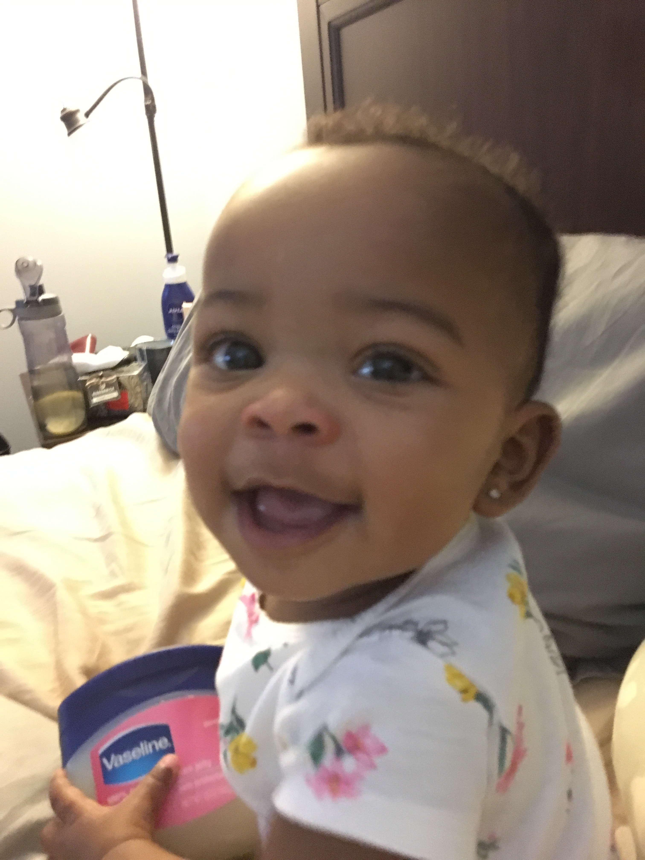
About Meeeeeeee Cont.

Slide 4
Meet the rest of Your Instructional Staff…
Tom Keel
Kyle Hoernlein
Joe Logue

Slide 5
About YOU!
Who Are You?
Where are you from?
What’s your background?
What’s your bootcamp mission?
Fun fact?
“I’m Going to Crush this bootcamp!”

Slide 6
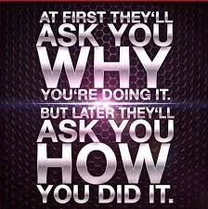
These are your goals! Stay focused!

Slide 7
The Path of Learning
Notes:
It’s important to keep in mind why you joined this class. Let’s talk about your goals.

Slide 8

Being A Developer === Lifelong Learning

Slide 9
Support Team
Our Promise:
IF you put in the time and effort, we will be here to help you 100% of the way.
This goes for everyone working behind the program:
Instructors
TAs
Student Success Team
Career Coaches
Everyone!
Notes:
This program will not be a traditional college class. We're here to support you 100% of the way to really help you achieve their goals.

Slide 10
But Remember…
Nothing good comes easy.
Notes:
There are a few things you can do to ensure your success

Slide 11
On Keys To Success…

Slide 12
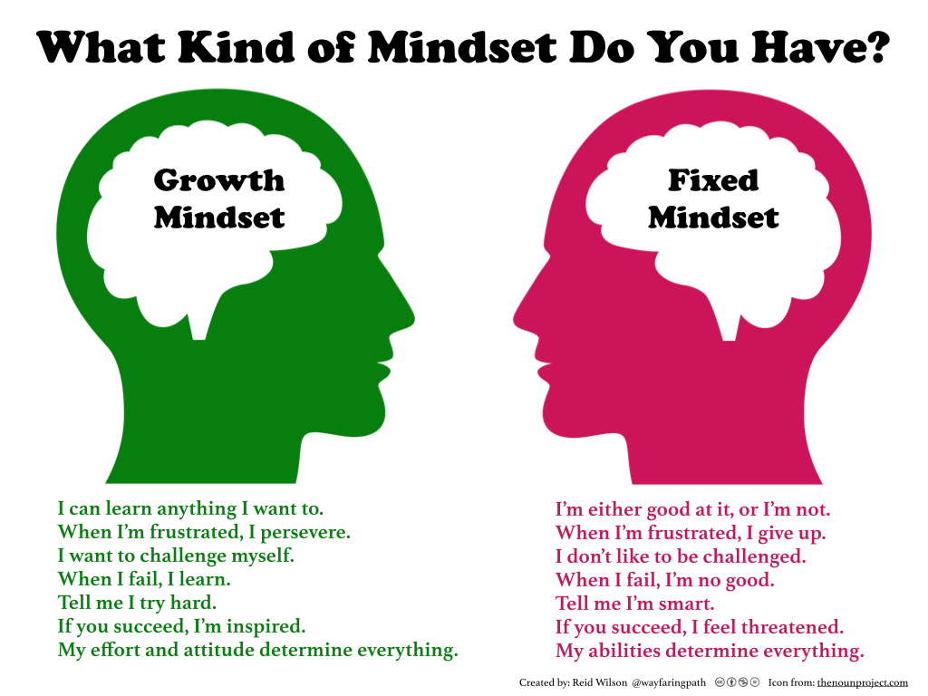
Mindset

Slide 13
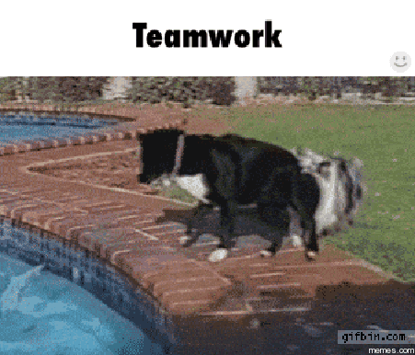
Community Effort A.K.A. Teamwork

Slide 14

Focus

Slide 15

Google Fu

Slide 16
The Path of Learning cont’d.
Notes:
So how does one learn? Well…

Slide 17
Nothing Comes Easy…
Learning to Code Requires Two Things:
Persisting in the face of something that feels incredibly hard and confusing.
Maintaining the self-confidence necessary to believe that you CAN DO THIS.
Notes:
And will take a while to master. Persisting in general is the #1 hardest thing in this course.
Perhaps tied with having self-confidence (talk about imposter syndrome).

Slide 18
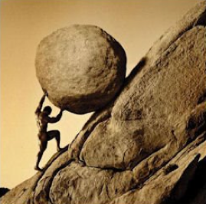
Work Hard

Slide 19
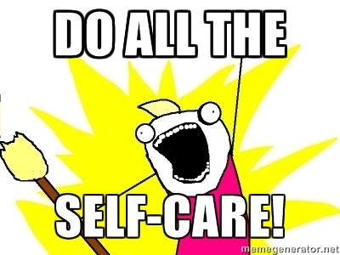
Advice for the Journey
Throughout this course, always remember to:
Work Hard!!
Appreciate your successes

Slide 20

Celebrate the Small Victories

Slide 21

Trust Yourself…When in doubt just ask though
Notes:
Questions?

Slide 22
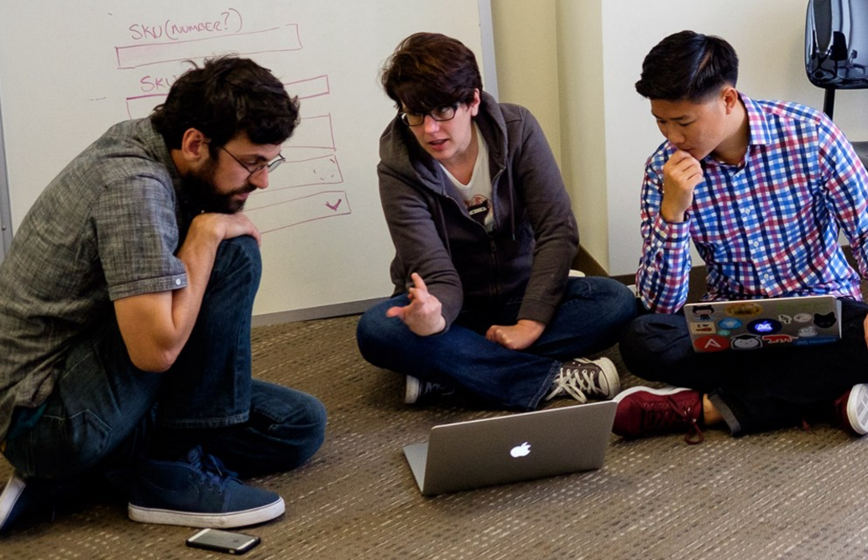
But remember…
If you want to go fast, go alone.
If you want to go far, go in a team.

Slide 23
Course Structure
Notes:
Now that we’ve talked about the journey and how to be successful, let’s talk about the stops along the way.

Slide 24
Daily Schedule
For each class we’ll run through the following:
Set Objectives
Brief Background Lecture
Watch Me / Coding Demos
Code Discussions
In-Class Exercises
Project Work
Notes:
Here’s what our days will look like.
Question: How do you learn to code? (NEXT)

Slide 25
Daily Schedule
For each class we’ll run through the following:
Set Objectives
Brief Background Lecture
Watch Me / Coding Demos
Code Discussions
In-Class Exercises
Project Work
The Super Important Stuff!!!
i.e. Always be coding!
Notes:
By coding! Unfortunate, right?
We’ll get a ton of in-class practice reading and writing code, so the course quickly becomes “code-centric”.
Most days will be much less presentation-heavy than today.
Questions?

Slide 26
Pre-Work
Notes:
So next up I want to spend a little bit of time checking that everyone has everything they need installed (from the pre-work).
If you can check off all of these things, spend this time helping your neighbors. This should become a habit – try to ask for help form your neighbors before going to a TA (you will both learn more along the way). < We’ll talk more about this soon.
That said, let’s check some things off of a list.

Slide 27
Software Checklist
At this point, you should have each of these installed:
Slack
Visual Studio Code
Git for Version Control
Git Bash (Windows) or Terminal (Mac)
Node.js
Heroku CLI
Google Chrome

Slide 28
Accounts Checklist
You should also now have accounts for:
GitHub (with SSH Integration)
Heroku
LinkedIn
Stack Overflow

Slide 29
Self-Check
Let’s do some quick checks of the following
Sublime Check
Git Bash / Terminal Check
Node Check
Git Check
Heroku Check

Slide 30
On the Modern Web

Slide 31
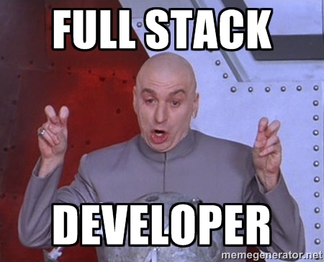
Full-Stack Development?
Notes:
So what exactly does it mean to be a “full stack developer?”

Slide 32

The “Magic” of YouTube
Notes:
Let’s use YouTube as an example. (Go to YouTube and do basic search)
You’ll learn all of this in time, but a basic YouTube search requires two things:
A ”frontend” – the graphical user interface which responds to what I type
A “backend” – the code on the “server side” that is able to do the logic behind the search, find the relevant videos, and send them along
(Go to next slide)

Slide 33
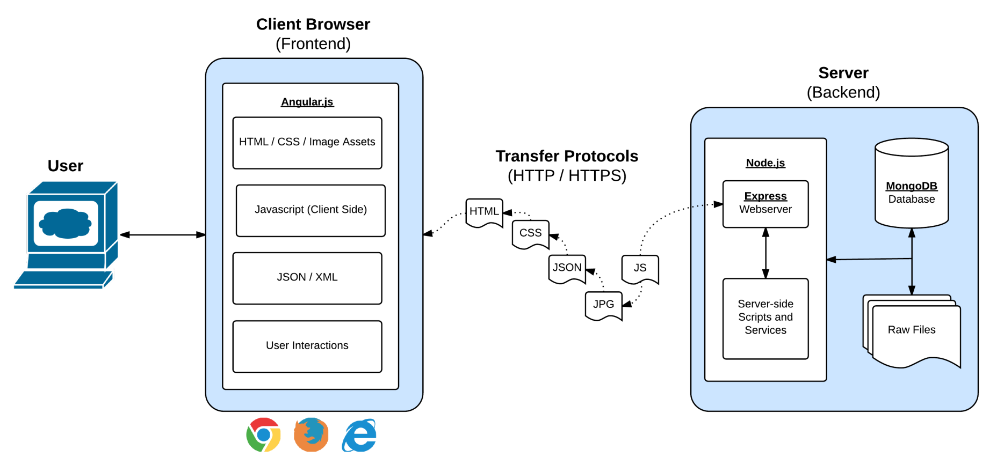
Full-Stack Development
In modern web apps, there’s a constant back-and-forth communication between two key components: the visuals displayed on the user’s browser (frontend) and the data and logic stored on the server (backend).
Notes:
Websites today are all about reading code for these components – “frontend” and “backend”

Slide 34
Full-Stack Development
Full-Stack Development is the concept of building every aspect of the web application – from the visuals and interactions, to the data transfer and processing.
Notes:
That is “Full-Stack Development” – you build can and will build the whole thing.

Slide 35
Full-Stack Development
The Browser
Dev Tools
Server Side
HTML
CSS
JavaScript
jQuery
Bootstrap
SEO
Heroku
Git
GitHub
Templating Engines
Sessions
Writing tests
Node.js
Express.js
Creating APIs
MVC
User Authentication
ORM (Sequelize)
Databases
MySQL
MongoDB
API Interaction
APIs (Consuming)
JSON
AJAX
Real Time Cloud Database via Firebase
Algorithms
Design Patterns
CS Fundamentals
Cutting Edge Development
React.js
Notes:
In this course, you’ll learn everything you need to be able to do this –
you’ll be able to build complex web applications even as a single developer.
Questions?

Slide 36
Let’s Get Crackin!

Slide 37

Intro to Console / Terminal
Notes:
The terminal is the portal to your computer – it allows you to run and even script commands that can create files, folders, and more.
It is extremely important that you get intimately familiar with the terminal as soon as possible, as you’ll use it for almost everything. It is fast and powerful.
NEXT

Slide 38
INSTRUCTOR DEMO
Instructor: Demo
(01-ConsoleCommands)
Notes:
So let’s run through a couple of examples.

Slide 39
> YOUR TURN!
Activity: Get Situated | Suggested Time: 1 min
Assignment:
Make a folder on your desktop named code.
Put all of your code that you do inside of that folder.
Best Practices:
Always use lowercase for folder and file names.
Never put in spaces in your folder and file names.
Use dashes to separate.
Notes:
Your turn!

Slide 40
> YOUR TURN!
Activity: Console Commands | Suggested Time: 12 min
Assignment:
From the Terminal / Console and using only the command line, create:
A new folder with the name of first_day_stuff.
A new HTML file with the name of first_day.html.
Open the current folder containing the new HTML file.
Bonus:
Create multiple directories/folders with the names one_folder and second_folder in one command.
Create multiple files with the names one.html and two.html in one command in the first_day_stuff directory.

Slide 41
Intro to Console
Discuss with Neighbors…
Notes:
Re-ask the questions after a couple of minutes walking neighbor-discussion:
How do you create a new folder?
How do you create a new file?

Slide 42
Hello, HTML
Notes:
Now that you can create HTML files from the terminal, let’s create one and actually write some HTML.

Slide 43

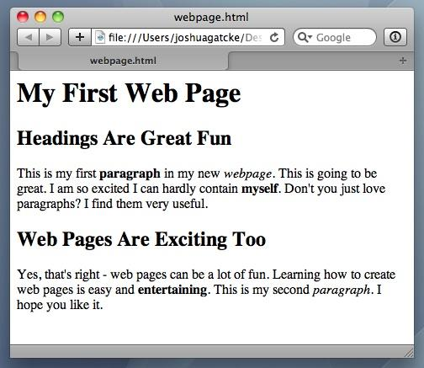
<title> Intro to HTML </title>
HTML is one of the three base languages behind every single website.
It defines all of the basic content and a bit of formatting.

Slide 44
> YOUR TURN
Assignment:
In a new HTML file, create the basic structure of an HTML document and include the following in it:
DOCTYPE declaration.
Head tag with a title tag.
H1 tag with a title of your choice.
Embed an image.
Create the following three links on your page:
One link that is target="_blank" so that it opens a new tab when clicked on.
Make the second link bold.
Make the third link a placeholder so it goes nowhere.
Bonus:
Create an ordered list of steps to make a sandwich.
Create an unordered list of 5 bands/musicians you like.
Create a table with 2 columns (animal class and animal name) and 4 rows of animals.
Use an alternate way of separating links without line breaks.
Embed a YouTube video of your favorite band/musician.

Slide 45

YouTube Video Walkthrough!
https://www.youtube.com/watch?v=ieb6Svbc10E&index=1&list=PLgJ8UgkiorCnMLsUevoQRxH8t9bt7ne14

Slide 46
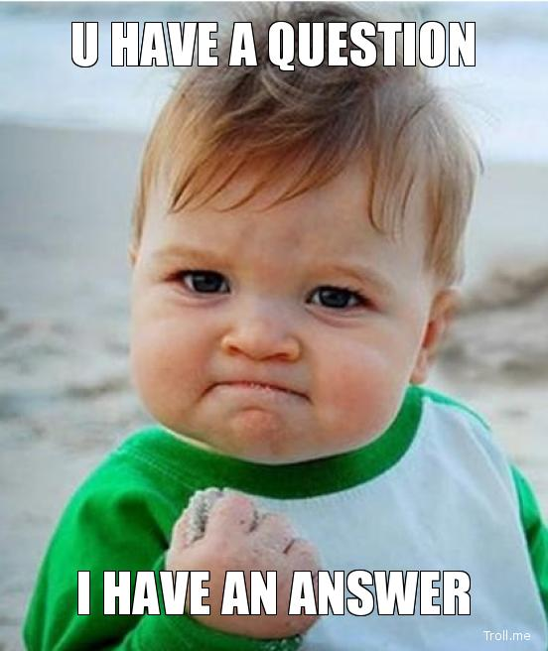
<title> Intro to HTML </title>
How’d it go?

Slide 47
LUNCH (40 Mins)

Slide 48
What / Why Git?

Slide 49
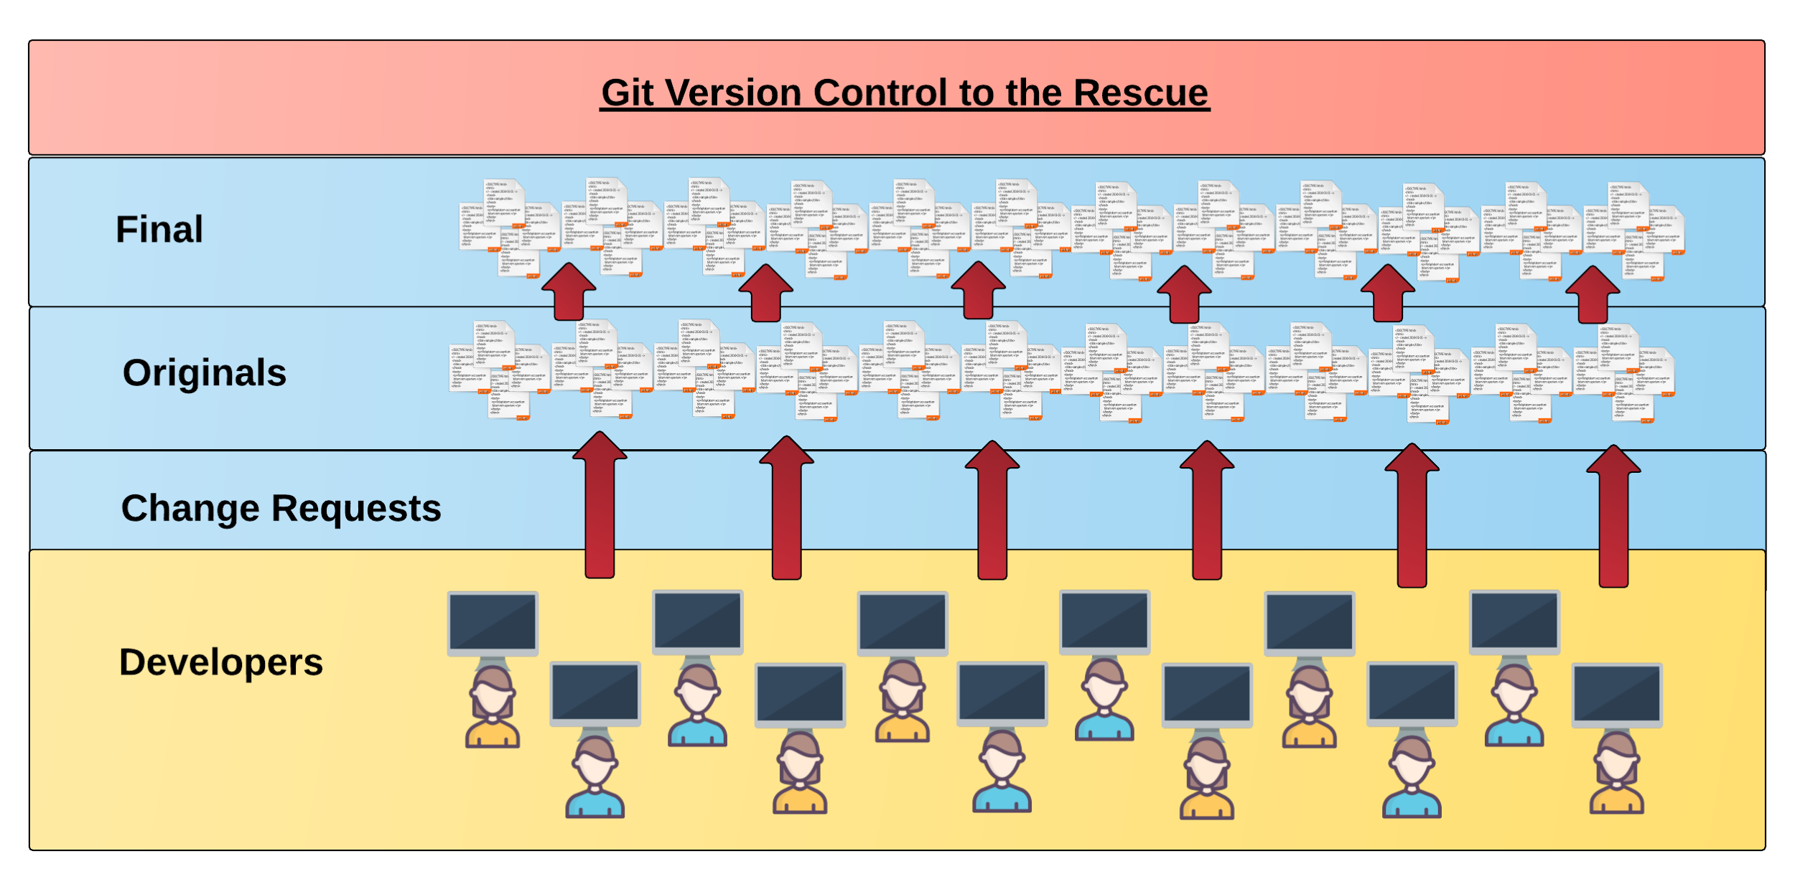
Collaborative Coding
Modern web development is highly collaborative.
Teams are often extremely large and separated across the country — or planet.
Apps sometimes comprise hundreds or even thousands of files.

Slide 50
Version Control
Git Version Control: Provides a organized system for managing code for when multiple developers work on a project
at the same time.
The Benefits of Git:
A strict system for resolving conflicts in code.
Version History.

Slide 51
Quick Activity!
Suggested Time: 3 min
Turn to your neighbor, and have one of you explain to the other:
The concept of version control.
Then the other should explain:
Two of the key advantages to using a version control system.

Slide 52

So… What’s this GitHub?
GitHub is a Web-Based hosting service to store code online.
It allows developers to pull (download) code or push (upload) code to the same repository (directory).
It also allows developers to view histories of code changes and to track issues.

Slide 53



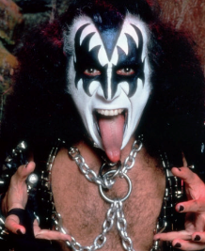

Pushing and Pulling to GitHub
1
2
3
4
GitHub Branch
Pull Code
Push Code
Pull Code
Pull Code
Push Code
Pull Code
Push Code

Slide 54
Get Started with Git

Slide 55
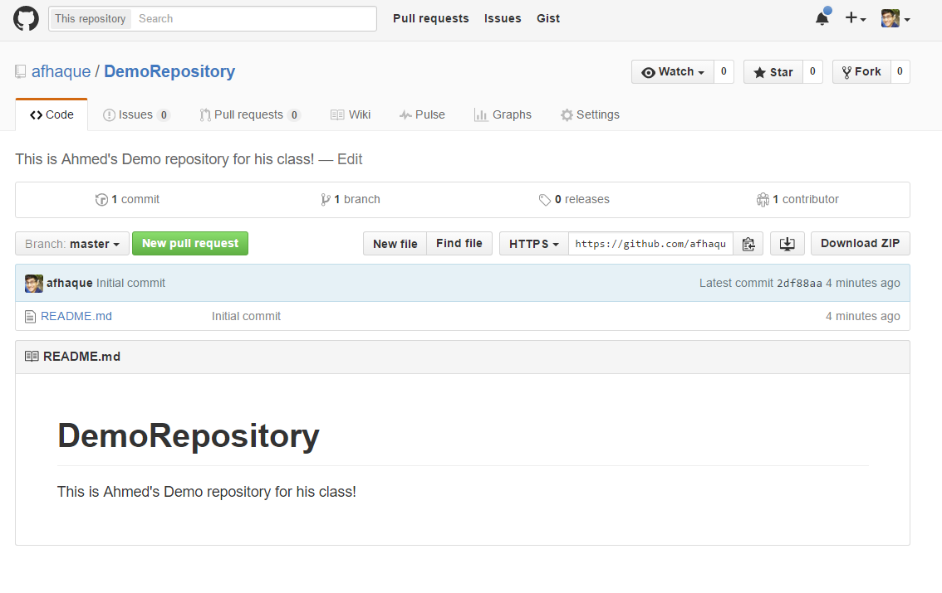
Instructor Git Demo!

Slide 56
Basic Git Commands
At its most basic, these are the five git commands to get started:
git clone
git add
git commit
git push
git pull

Slide 57
Basic Git Commands
At its most basic, these are the five git commands to get started:
git clone – copies an entire repo (to begin).
git add – adds a file for inclusion in Git.
git commit – notes a change to the local repo.
git push – sends changes to hosting service.
git pull – downloads freshest version of repo.

Slide 58
> YOUR TURN!
Activity: Git Add, Commit, Push | Suggested Time: 20 min
Assignment:
Using GitHub and the Command Line:
Create a new public GitHub repository and name it whatever you like. Be sure to check the box for “initialize this repository with a README.”
Next, clone the repo to your local directory.
Then create an HTML file inside the local directory.
Add, Commit, and Push the code to GitHub.
Bonus:
Find a partner in class, and fork their repository to your own GitHub account. Clone this forked repository to your local directory.
Add, Commit, and Push the code back to your forked copy.
Finally, submit a pull request to send your changes to your partner’s repo.

Slide 59

Still a Bit Lost? Never Worry!
Follow this handy Guide!
Practice a few times on your own before our next class.

Slide 60
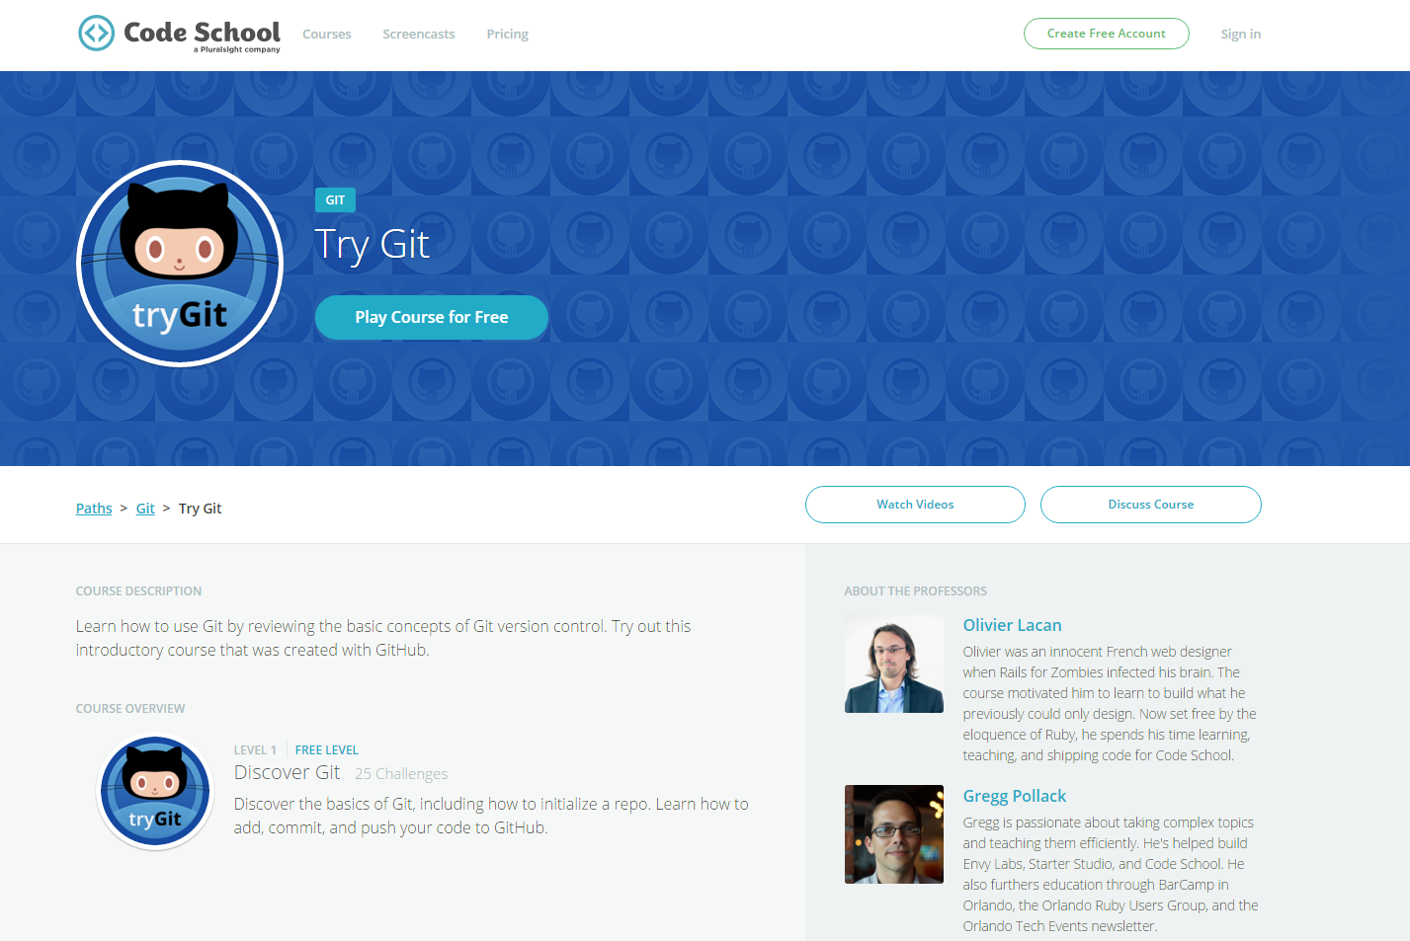
If You’re Still Lost… Here’s a (Free) Course
https://www.codeschool.com/courses/try-git

Slide 61
Homework!

Slide 62
Homework “Due”: This Week
By Next Class You Should:
Figure out where the GitHub Repo is for our class.
Re-do the Terminal example from class today.
Re-do the HTML example from class today.
Watch the Walkthrough Video if you felt a bit lost.
Review the Git commands we learned and how to use them

